Slide 1
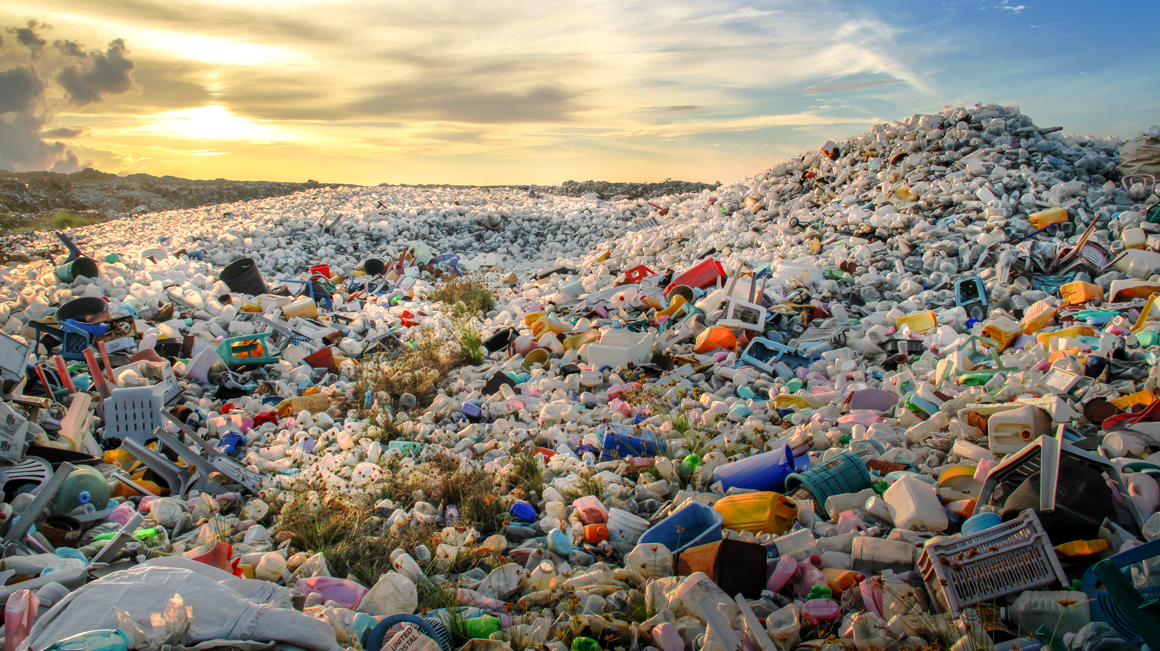
Automated Garbage Classification Using Deep Learning
BY Neha

Slide 2
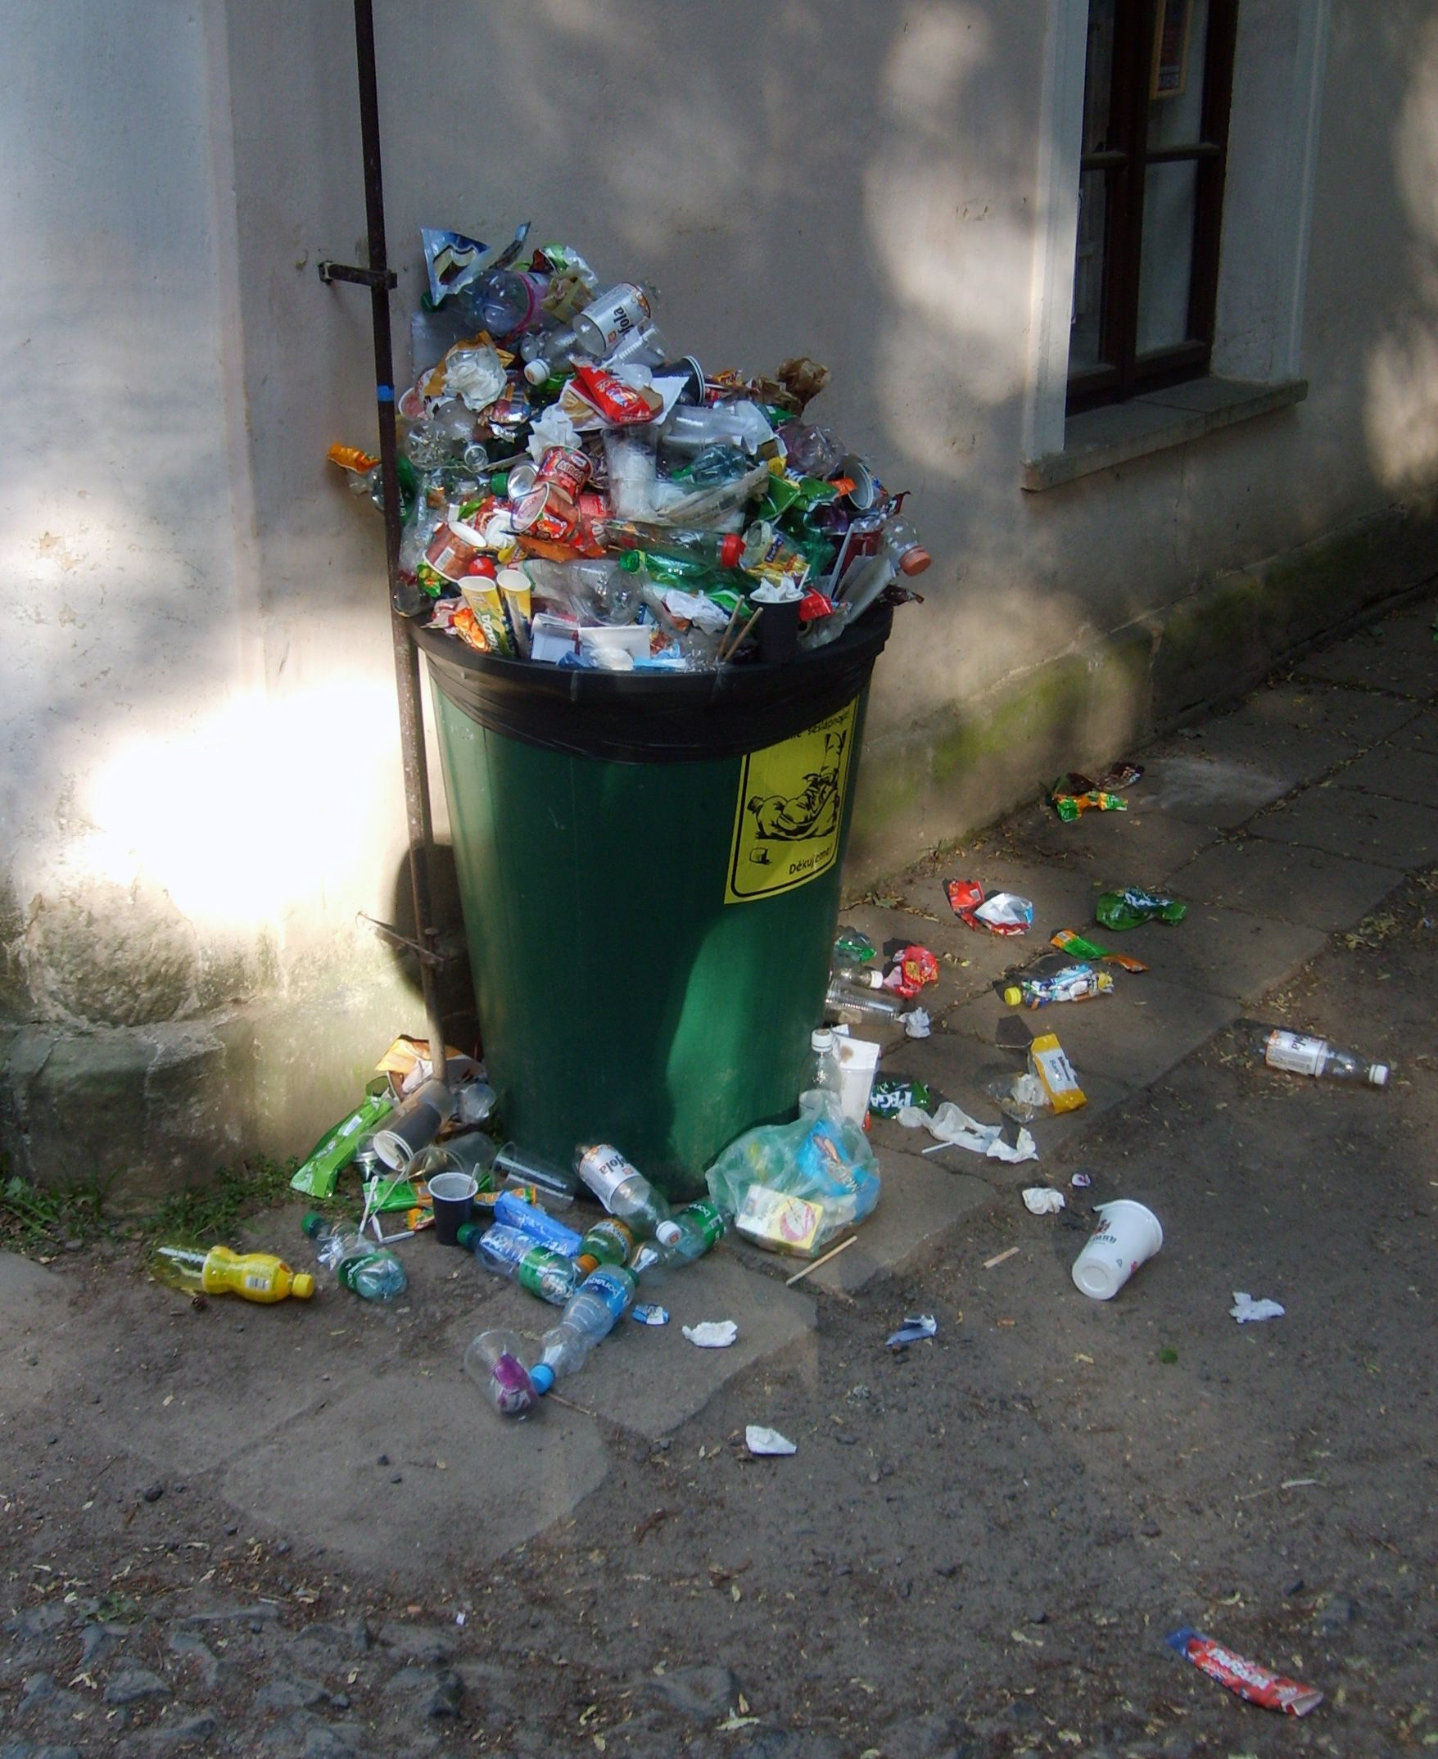
Overview
Introduction
Business Aspect
Data Collection
Data Preprocessing
Model Architecture
Training and Validation
Results
Deployment
Conclusion and Future Work

Slide 3
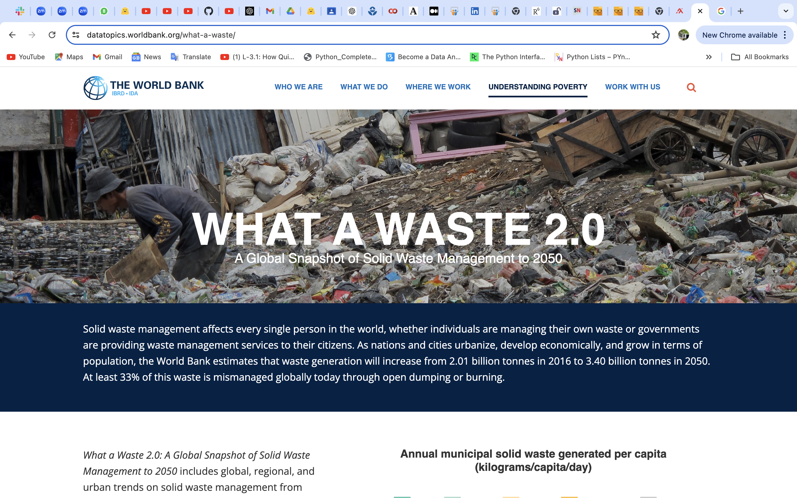
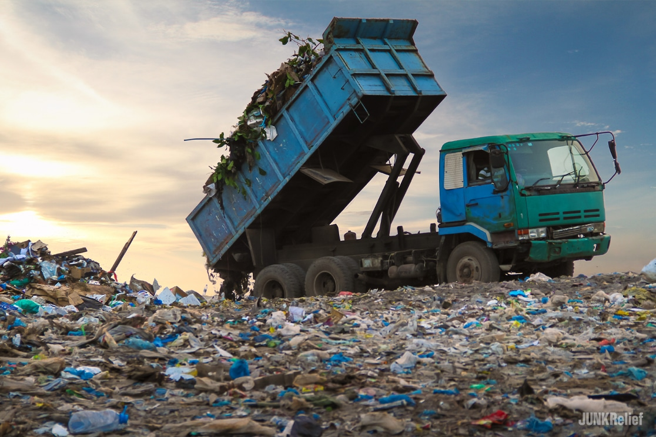
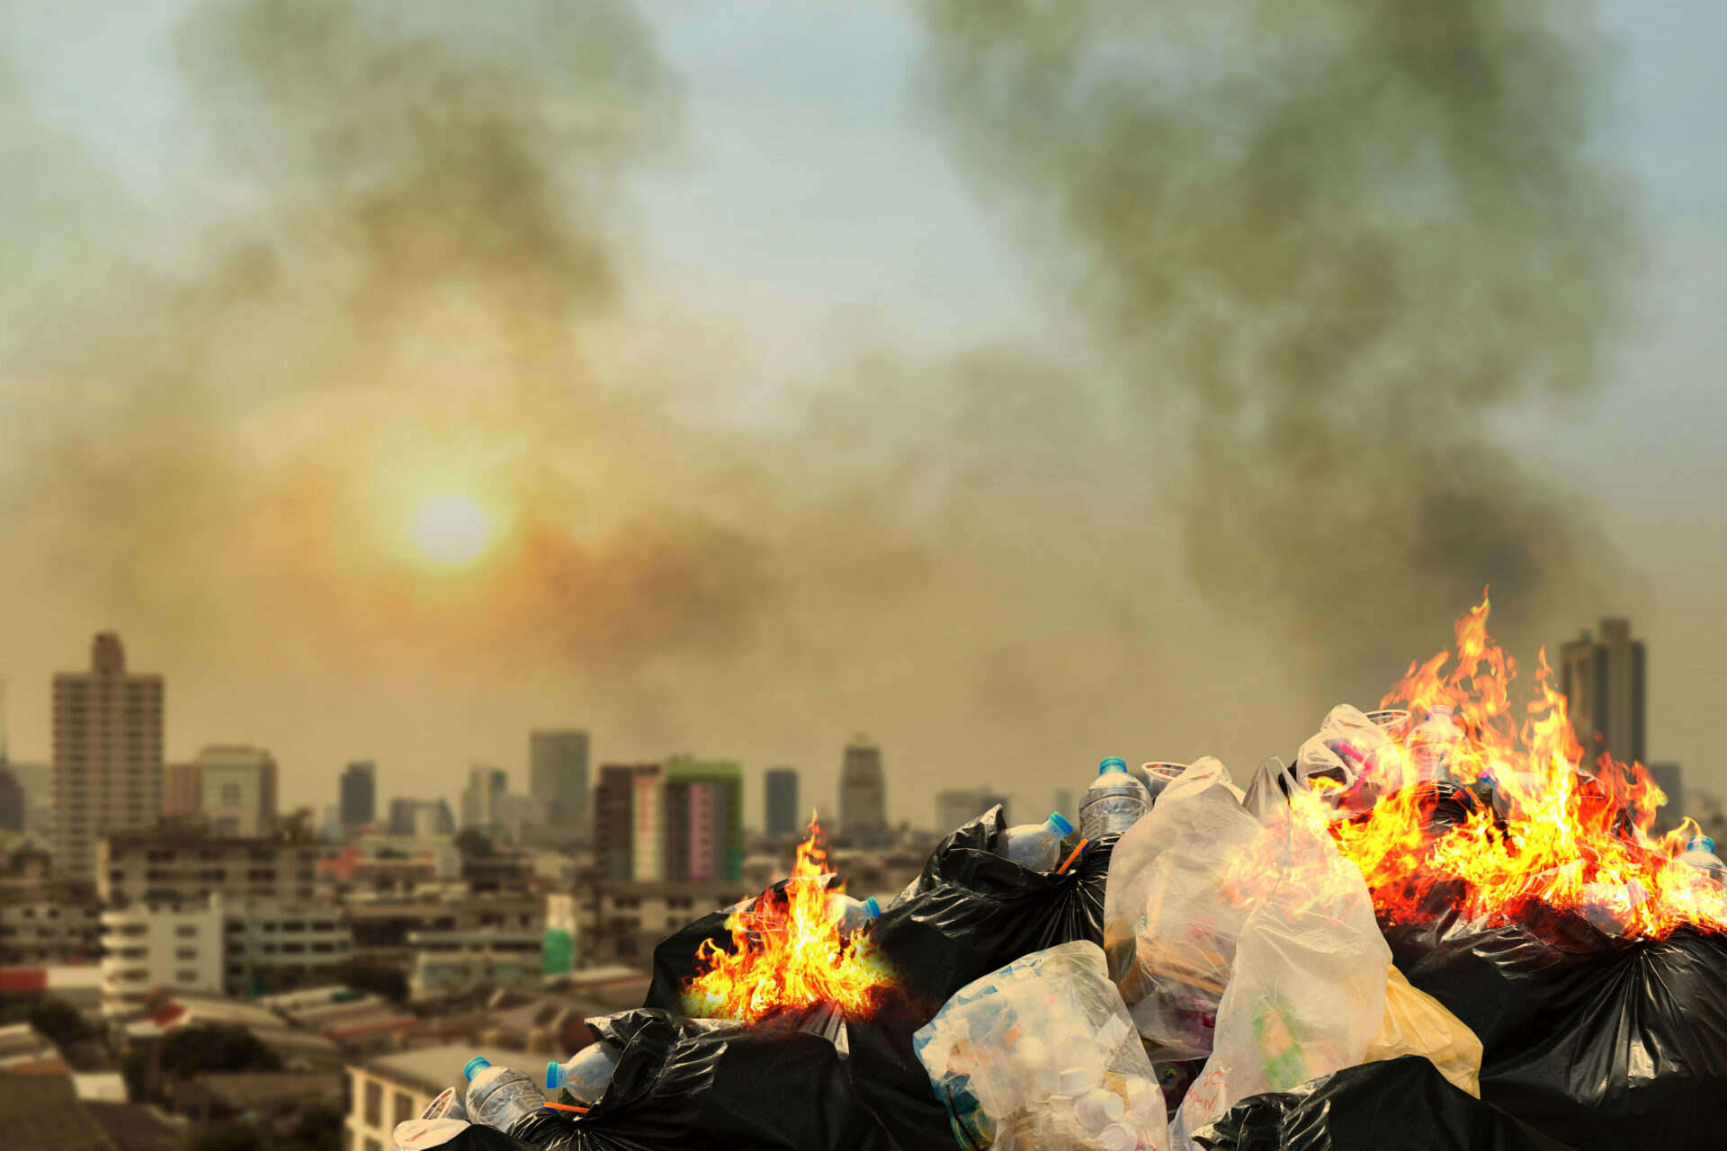
!
The world bank estimates global waste generation will increase to 3.40 billion tonnes in 2050.
The world produces over 2 billion tons of waste every year.
33% of waste is mismanaged globally through open dumping or burning.
"Waste is wealth placed in the wrong place."

Slide 4



Environmental Impact of Improper Garbage Management
Air
Pollution
Water Contamination
Soil
Degradation
How :
Burning waste releases toxic gases.
Cause respiratory issues.
Increases global warming.
How :
Waste in water bodies pollutes rivers, lakes, and oceans.
Affecting drinking water.
How :
Hazardous chemicals leach into soil.
Reduces soil fertility

Slide 5

Business Aspects
Project Aim:
Classify garbage into categories to ensure high-quality materials for recycling and reuse and reduce landfill waste.
Use deep learning to automate garbage sorting to reduce manual sorting and human error.
Decrease time and costs.
Research Question:
How can deep learning model automate garbage classification, improving recycling accuracy, while reducing environmental impact and operational costs?

Slide 6




Project Workflow
Data Analysis and Preparation:
* Collected, analyzed, visualized the image data and preprocessed it using resizing and encoding.
Models Preparation
* Split the data into training and validation sets.
STEP
01
STEP
03
Models Validation
* Used confusion matrices and accuracy charts to compare models and visualize results.
Analytical Approach
* Multiple deep learning models, specifically CNN architectures:
STEP
02
STEP
04

Slide 7
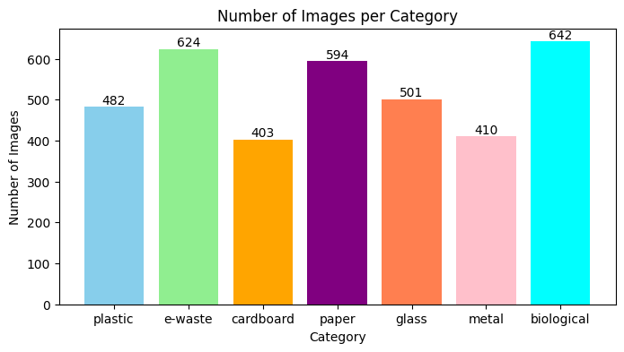
Dataset: Distribution of Images Across Categories
Dataset Source: obtained from Kaggle.
Total Images: 3655 images
Categories: 7 distinct categories.

Slide 8
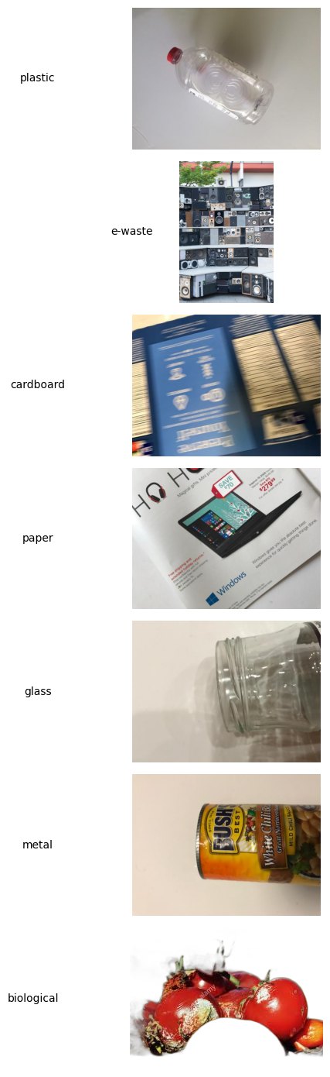
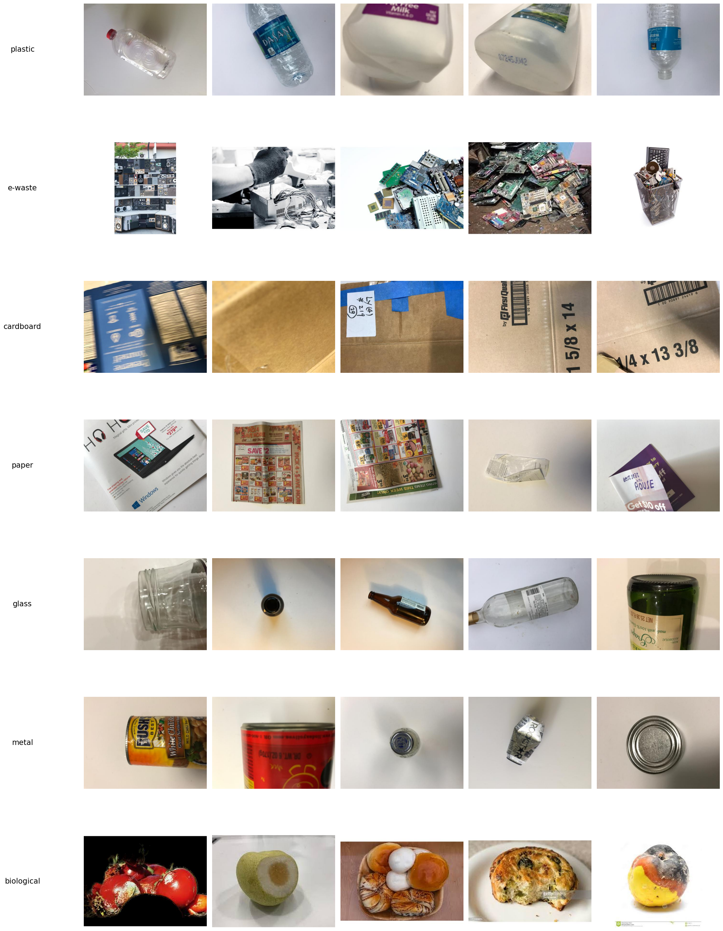
Standardizing Image Sizes for Consistent Model Training
Before Resizing
After Resizing
Resized to 512x384 Pixels

Slide 9
Data Preprocessing
One-Hot Encoding: Transform labels into a binary matrix.
Label Encoding: Each garbage category is assigned a unique numerical value.
Image Dimensions: Standardized to 128x128 pixels.
Batch Size: Set to 32 for efficient training.

Slide 10
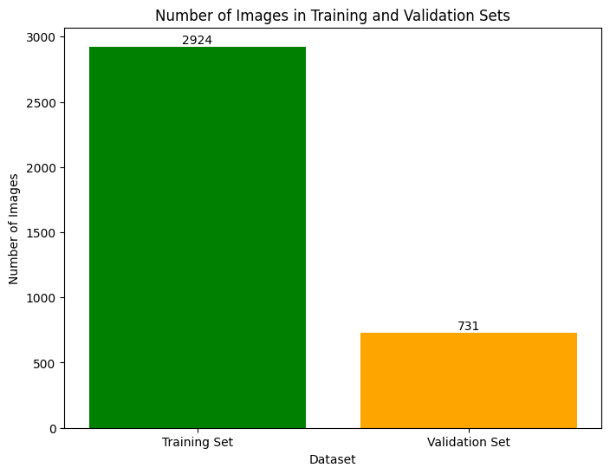
Training and Test Data Distribution
Training Set: 2,924 images used to train the model and learn features.
Test Set: 731 images used to evaluate model performance on unseen data.
Highlights a larger training set, emphasizing robust training and careful evaluation.

Slide 11
Model Training
STEP 1
STEP 2
STEP 3
STEP 4
Using Pre-trained Models: to save time and improve accuracy
VGG16
.ResNet50
InceptionV3
DenseNet121
EfficientNetB0
Used Transfer Learning and Fine tune the model
Compare the results
Initialize CNN: To identify features and classify images.
1. Used Adam optimizer and Trained the model for 20 epochs

Slide 12
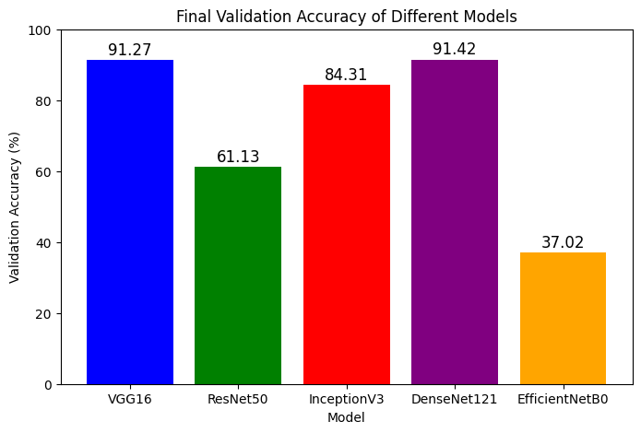
Validation Accuracy Comparison
DenseNet121: Achieved the highest validation accuracy of 91.42%.
VGG16: Close second with a validation accuracy of 91.27%.

Slide 13
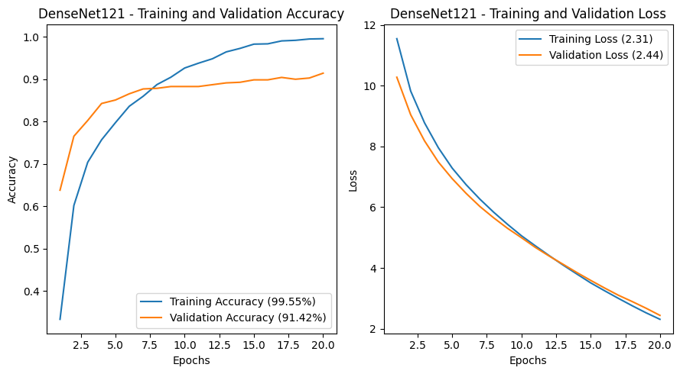
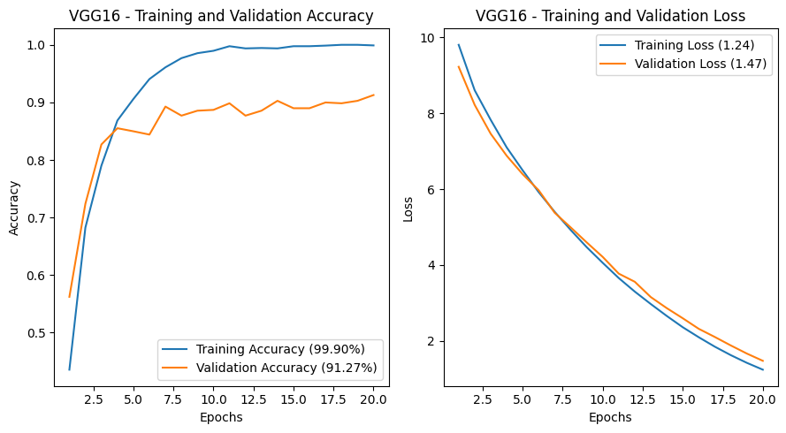
Model Accuracy Comparison
DenseNet121: showing strong learning and good generalization.
VGG16: performing excellently but with slight overfitting.
Comparison: Both models demonstrate high accuracy, with DenseNet121 slightly better on the validation set.

Slide 14
Model Loss Comparison
DenseNet121: Good convergence, minimal overfitting.
VGG16: Strong learning, slightly more overfitting than DenseNet121.
Comparison: Both models' loss curves decrease, with DenseNet121 showing better generalization.

Slide 15
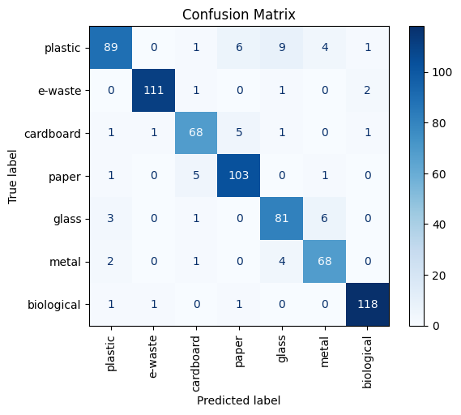
Confusion Matrix for VGG16
High accuracy: 'e-waste' and 'biological' categories have the highest correct predictions.
Common errors: ‘plastic' and is frequently misclassified as ‘paper’ and ‘glass’.
Model performance: strong overall, but improvements needed for specific misclassifications.

Slide 16
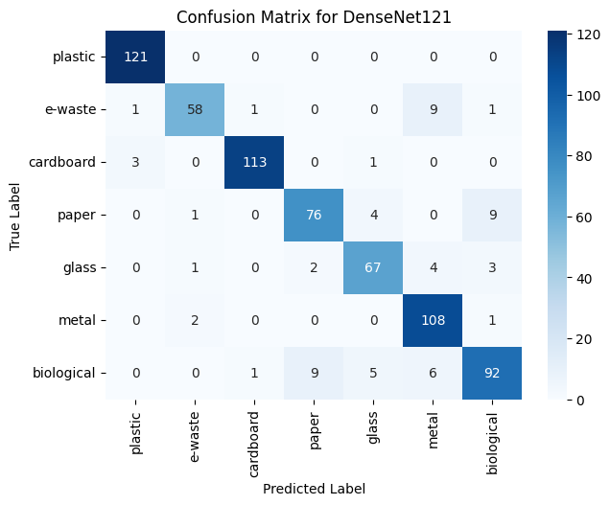
Confusion Matrix for DenseNet121
High accuracy: Accurate across most categories, especially 'plastic' and 'cardboard’.
Common errors: Misclassifications such as 'e-waste' occasionally confused with ‘biological’.
Model performance: Balanced and robust classification ability with fewer errors.
Comparison: Better than VGG16.

Slide 17
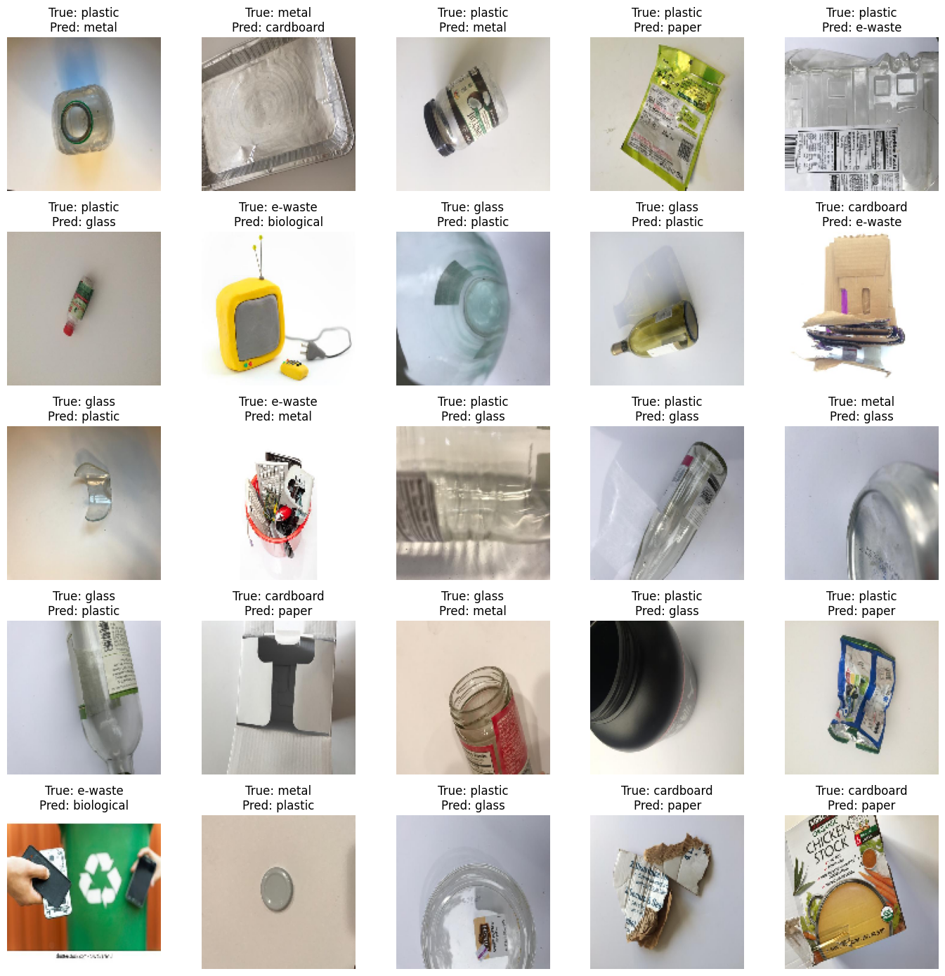
Analysis of Misclassified Images
Reflective Surfaces: Metal frequently mistaken for plastic due to their reflective surfaces.
Visual Similarities: Items like plastic and glass often get confused due to similar textures.
Complex Shapes and Colors: E-waste confused with biological because of complex shapes and colors.

Slide 18
Deployment
Hugging Face Deployment:
The model is deployed on Hugging Face for easy access and usage.
User Interaction:
Users can upload images directly to the Hugging Face interface to receive instant classification results.
Application Link

Slide 19
Conclusion
Model Performance: Both VGG16 and DenseNet121 demonstrated high accuracy, with DenseNet121 showing slightly better generalization and stability.
Misclassification Insights: Common misclassifications were observed due to visual similarities and variations in lighting and angles.
Best Model: DenseNet121 achieved a validation accuracy of 91.42%, indicating robust performance for garbage classification tasks.

Slide 20
Potential areas of improvement and Future Research
Expand Dataset:
Increase the diversity and size of the image dataset for better model robustness.
Advanced Categorization:
Implement more specific garbage categories such as biodegradable, recyclable, and non-recyclable.
Utilize YOLO for object detection to classify and detect multiple garbage types in a single image.
Integrate Ensemble Methods:
Combine predictions from multiple models using ensemble techniques to improve overall performance and reliability.

Slide 21



“Garbage classification is the first step towards a cleaner and greener world”
THANK YOU !!
Any Question ?

